Slide 1
Viewpoint

Slide 2
Views, Viewpoints, and Stakeholders
In general, a view is defined as a part of an architecture description that addresses a set of related concerns and is addressed to a set of stakeholders.
A view is specified by means of a viewpoint, which prescribes the concepts, models, analysis techniques and visualisations that are provided by the view.
Simply put, a view is what you see, and a viewpoint is where you are looking from.

Slide 3
Views, Viewpoints, and Stakeholders
Viewpoints are a means to focus on particular aspects of the architecture. These aspects are determined by the concerns of a stakeholder with whom communication takes place.
What should and should not be visible from a specific viewpoint is therefore entirely dependent on the argumentation with respect to a stakeholder’s concerns.

Slide 4
Views, Viewpoints, and Stakeholders
Viewpoints are designed for the purpose of communicating certain aspects of an architecture. The communication enabled by a viewpoint can be strictly informative, but, in general, will be bi-directional.
The architect informs stakeholders, and stakeholders give their feedback (critique or consent) on the presented aspects.

Slide 5
The following are examples of stakeholders and concerns as a basis for the specification of viewpoints:
  End user. E.g.: What are the consequences for his work and workplace?
  Architect. What is the consequence for the maintainability of a system, with respect to corrective, preventive and adaptive maintenance?
  Upper-level management. How can we ensure our policies are followed in the development and operation of processes and systems? What is the impact of decisions (on personnel, finance, ICT, etcetera)?

Slide 6
  Operational manager, responsible for exploitation or maintenance. E.g.: What new technologies are there to prepare for? Is there a need to adapt maintenance processes? What is the impact of changes to existing applications? How secure are my systems?
  Project manager, responsible for the development of new applications. What are the relevant domains and their relations, what is the dependence of business processes on the applications to be built? What is their expected performance?
  Developer. What are the modifications with respect to the current situation that need to be done?

Slide 7
Viewpoint Classification Framework
Our viewpoint classification framework is based on two dimensions, purpose and content.The framework distinguishes between three main types of purpose:
  Designing – Design viewpoints support architects and designers in the design process from initial sketch to detailed design. Typically, design viewpoints consist of diagrams, like those used in e.g. UML.
  Deciding – Decision support views assist managers in the process of decision making by offering insight into cross-domain architecture relations, typically through projections and intersections of underlying models, but also by means of analytical techniques. Typical examples are cross-reference tables, landscape maps, lists and reports.
  Informing – These viewpoints help to inform any stakeholder about the enterprise architecture, in order to achieve understanding, obtain commitment, and convince adversaries. Typical examples are illustrations, animations, cartoons, flyers, etc.

Slide 8
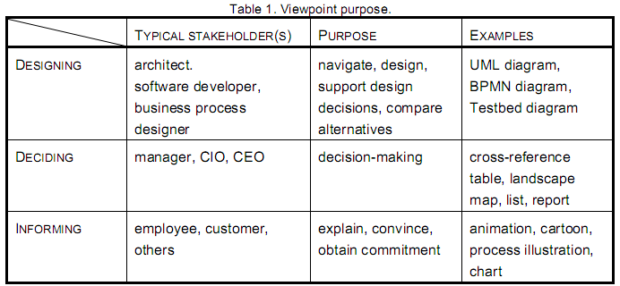

Slide 9
For characterising the content of a view we define the following abstraction levels:
  Details – Views on the detailed level are typically focussed on one layer and one aspect from the ArchiMate framework (Figure 15). Typical stakeholders are a software engineer responsible for design and implementation of a software component or a process owner responsible for effective and efficient process execution. Examples of views are a Testbed process diagram and a UML class diagram.
  Coherence – At the coherence abstraction level, either multiple layers are spanned or multiple aspects. Extending the view to more than one layer or aspect enables the stakeholder to focus on architecture relations like process-uses-system (multiple layer) or application-uses-object (multiple aspect). Typical stakeholders are operational managers responsible for a collection of IT services or business processes.
  Overview – The overview abstraction level addresses both multiple layers and multiple aspects. Typically such overviews are addressed to enterprise architects, and decision makers such as CEOs and CIOs.

Slide 10
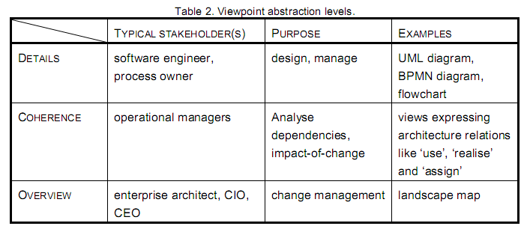

Slide 11
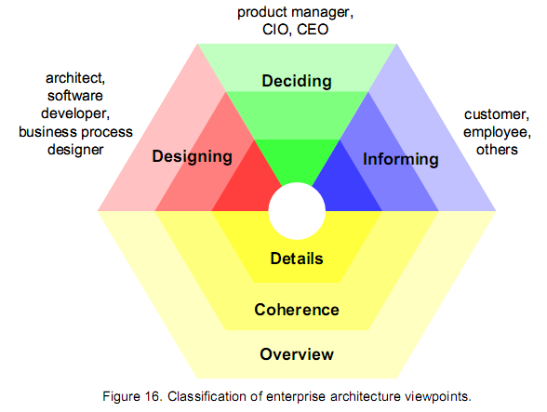

Slide 12
Design Viewpoints
There’re three types of design viewpoints.
  The first type, called basic design viewpoints defines a set of diagram types for the ArchiMate language. In addition to a number of aspect- or layer-specific diagrams, a set of coherence diagram types are introduced that cover multiple layers and/or multiple aspects.
  The second type is the layered view, which is an overview type of view that presents multiple aspects and multiple layers in one layered diagram.
  The third type of view shows how form and content of a view can be adapted to the needs of stakeholders using a set of abstraction and presentation rules.

Slide 13
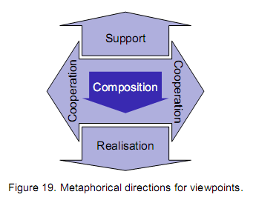
Basic Design Viewpoints
From any given element in a model, we can define viewpoints in four metaphorical directions (inspired by Veryard 2004):
  ‘ inwards’, toward the internal composition of the element;
  ‘upwards’, towards the elements that are supported by it;
  ‘downwards’, toward its realisation by other elements;
  ‘sideways’, towards peer elements with which it cooperates.

Slide 14
Basic Design Viewpoints
From this basic structure, we can deduce a first set of viewpoint types, containing three viewpoints that are centered around one specific type of concept:
  active elements, e.g., the composition of a business actor from subactors, i.e., an organisation structure;
  behaviour elements, e.g., the structure of a business process in terms of subprocesses;
  passive elements, e.g., the information structure in terms of data objects.

Slide 15
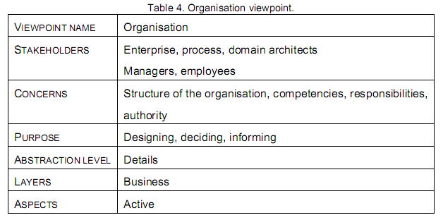
5.1.1 Organisation Viewpoint
The Organisation viewpoint shows the structure of an internal organisation of the enterprise, department, or other organisational entity. It can be represented in the form of a nested block diagram, but also in more traditional ways like the organigram.
An Organisation view is typically used to identify authority, compentencies, and responsibilities within an organisation.

Slide 16
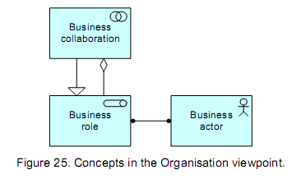
Contents Organisation Viewpoint

Slide 17
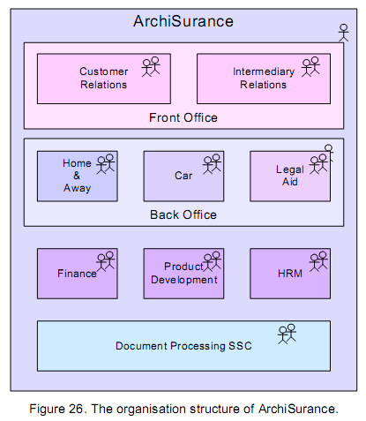
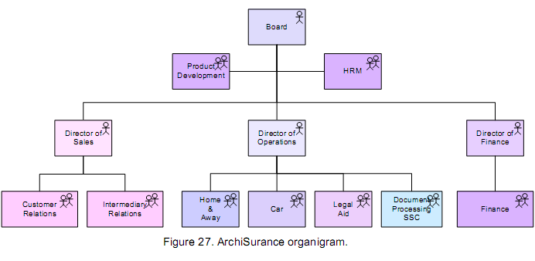
Example Organisation Viewpoint

Slide 18
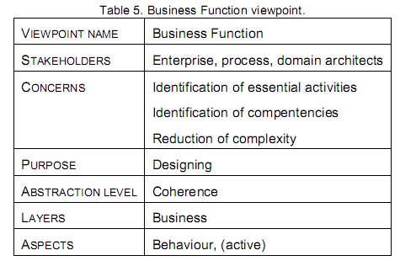
5.1.2 Business Function Viewpoint
The Business Function viewpoint shows the main business functions of an organisation and their relations in terms of the flows of information, value or goods between them.
Business functions are used to represent what is most stable about a company in terms of the primary activities it performs, regardless of organisational changes or technological developments.

Slide 19
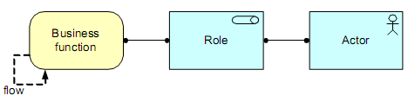
Contents Business Function Viewpoint

Slide 20
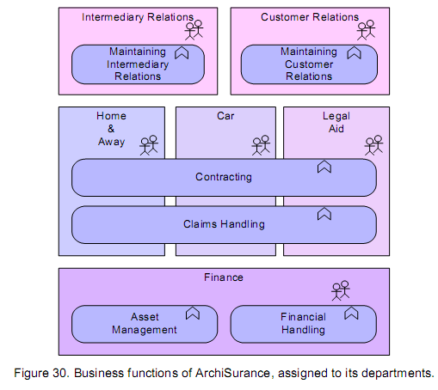
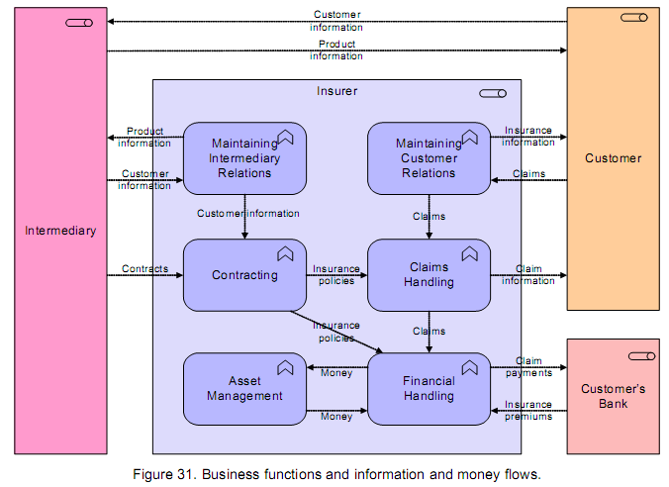
Example Business Function Viewpoint

Slide 21
5.1.3 Business Process Viewpoint
The Business Process viewpoint is used to show the high-level structure and composition of one or more business processes.
This viewpoint contains other directly related concepts, such as:
  the services a business process offers to the outside world, showing how a process contributes to the realisation of the company’s products;
  the assignment of business processes to roles, which gives insight into the responsibilities of the associated actors;
  the information used by the business process.

Slide 22
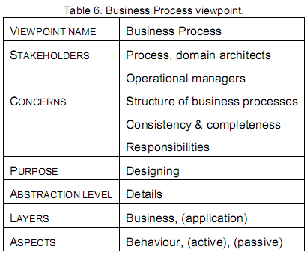

Slide 23
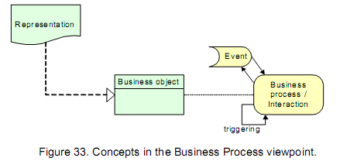
Contents

Slide 24
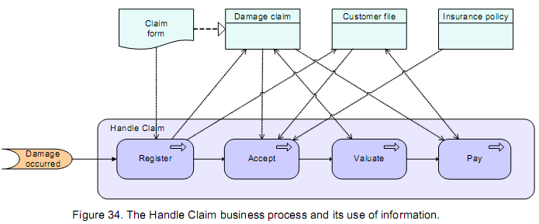
Example

Slide 25
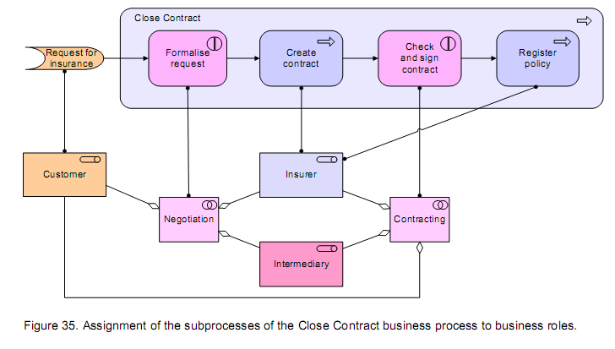
Example

Slide 26
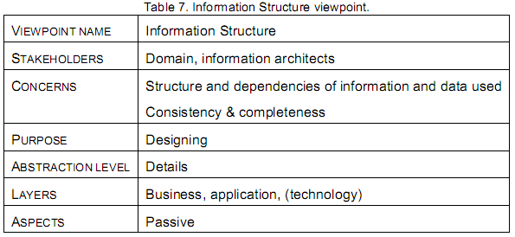
5.1.4 Informat ion St ructure Viewpoint
The Information Structure viewpoint is basically identical to the traditional information models created in the development of almost any information system.
It shows the structure of the information used in the enterprise or in a specific business process or application, in terms of data types or (object-oriented) class structures.

Slide 27
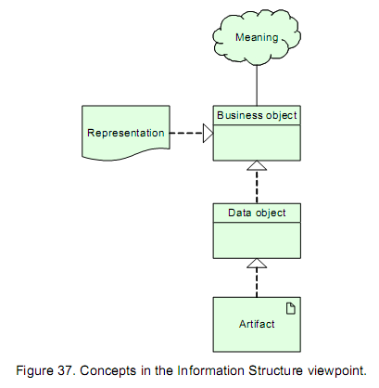
Contents

Slide 28
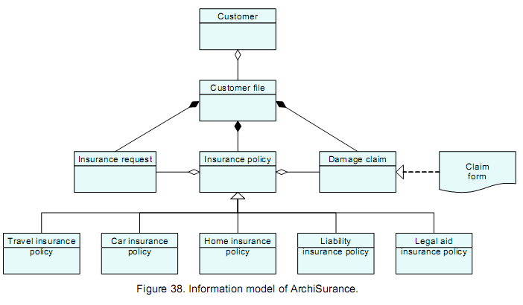
Example

Slide 29
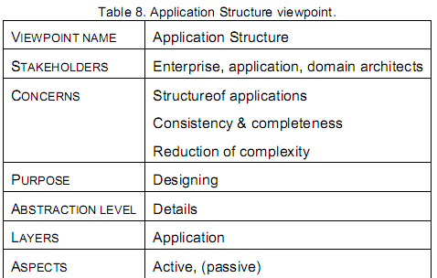
5.1.5 Appl icat ion St ructure Viewpoint
The Application Structure viewpoint shows the structure of one or more applications or components.
This viewpoint is useful in designing or understanding the main structure applications or components and the associated data, e.g. to create a first step work breakdown structure for building a system, or in identifying legacy parts suitable for migration.

Slide 30
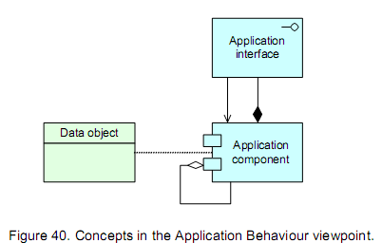

Slide 31
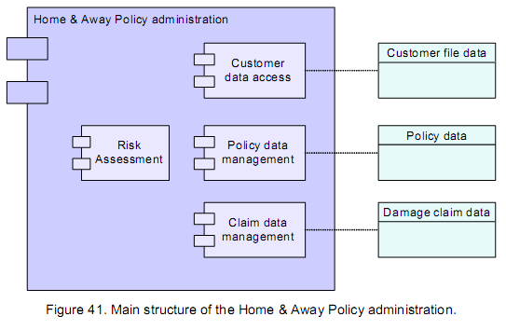

Slide 32
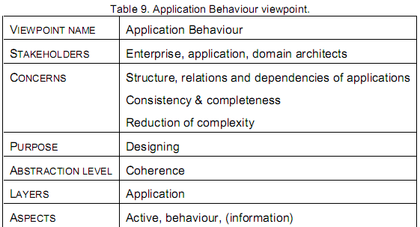
5.1.6 Appl icat ion Behaviour Viewpoint
The Application Behaviour viewpoint describes the internal behaviour of an application or component, e.g. as it realises one or more application services.
This viewpoint is useful in designing the main behaviour of applications or components, or in identifying functional overlap between different applications.

Slide 33
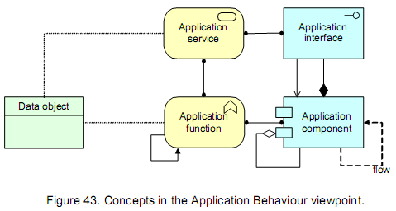

Slide 34
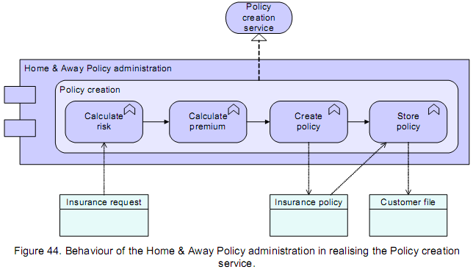

Slide 35
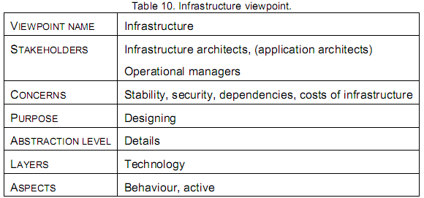
5.1.7 Inf rast ructure Viewpoint
The Infrastructure viewpoint comprises the hardware and software infrastructure upon which the application layer depends.
It contains physical devices and networks, and supporting system software such as operating systems, databases and middleware.

Slide 36
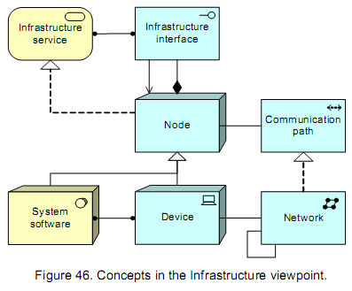

Slide 37
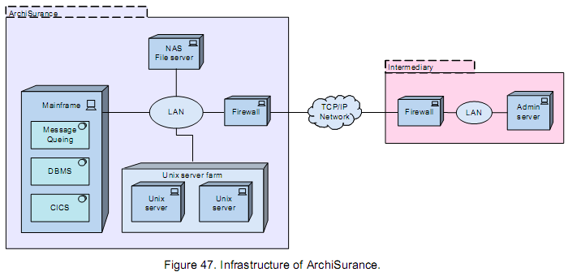

Slide 38
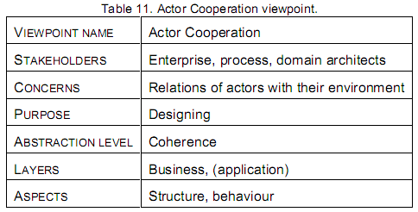
5.1.8 Actor Cooperat ion Viewpoint
The Actor Cooperation viewpoint focuses on the relations of actors with each other and their environment.
A common example of this is what is sometimes called a ‘context diagram’, which puts an organisation into its environment, consisting of external parties such as customers, suppliers, and other business partners.

Slide 39
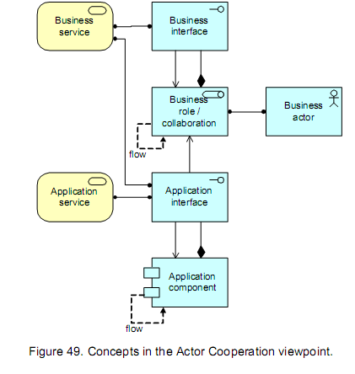

Slide 40
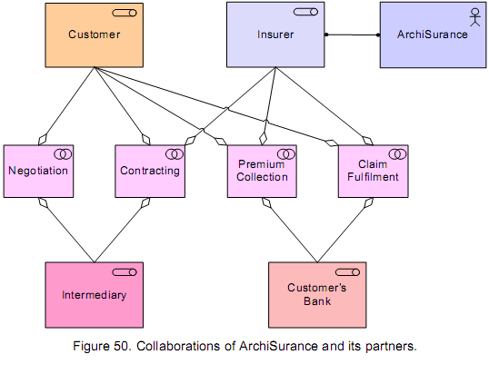

Slide 41
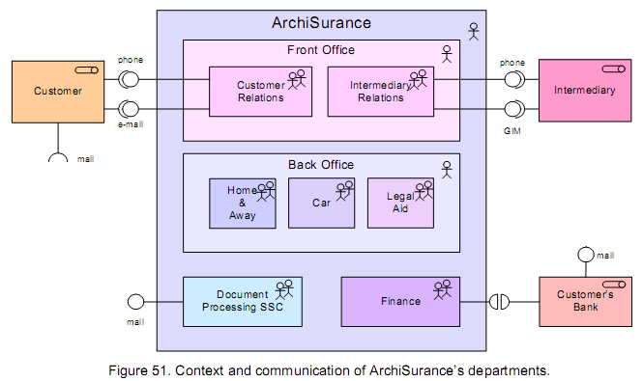

Slide 42
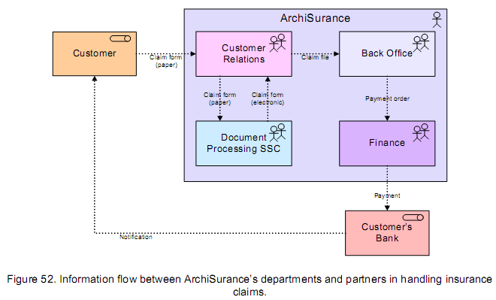

Slide 43
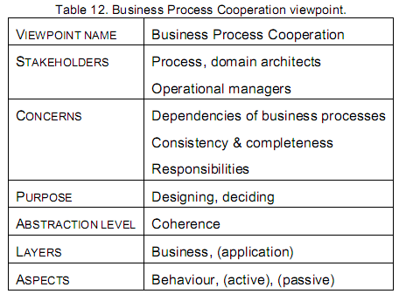
5.1.9 Business Process Cooperat ion Viewpoint
The Business Process Cooperation viewpoint is used to show the relations of one or more business processes with each other and/or their surroundings.
It can both be used to create a high-level design of business processes within their context and to provide an operational manager responsible for one or more such processes with insight in their dependencies.

Slide 44
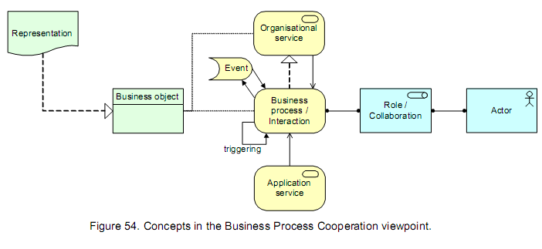

Slide 45
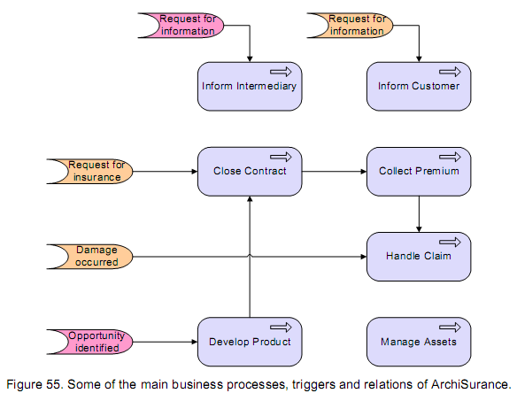

Slide 46
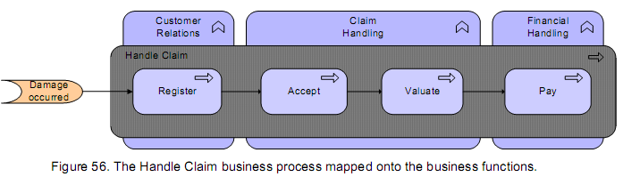

Slide 47
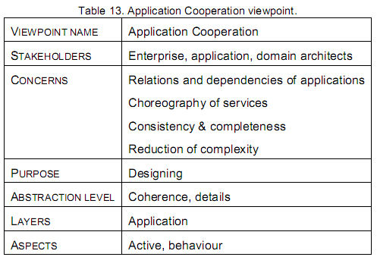
5.1.10 Appl icat ion Cooperat ion Viewpoint
The Application Cooperation viewpoint shows the relations of a number of applications or components. It describes the dependencies in terms of the information flows between them, or the services they offer and use.
This viewpoint is typically used to create an overview of the application landscape of an organisation.

Slide 48
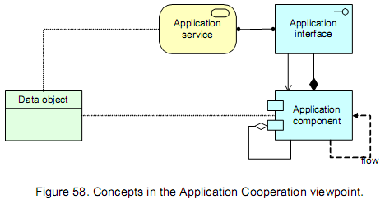

Slide 49
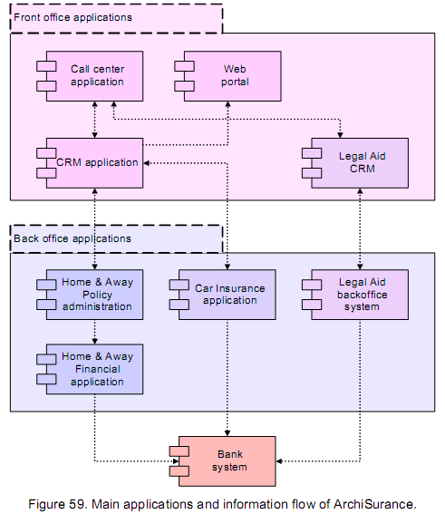

Slide 50
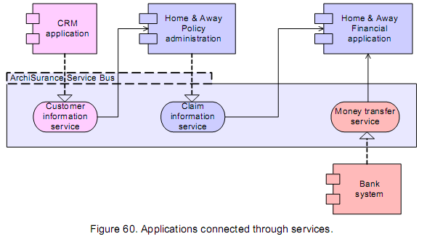

Slide 51
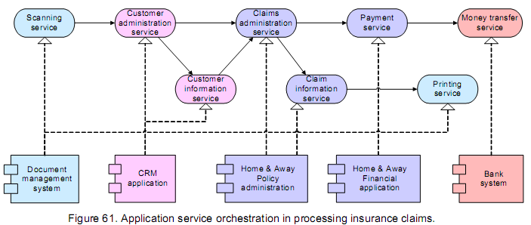

Slide 52
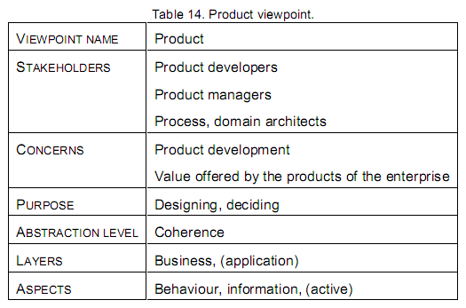
5.1.11 Product Viewpoint
The Product viewpoint depicts the value this product offers to the customers or other external parties involved and shows the composition of one or more products in terms of the constituting (business or application) services, and the associated contract(s) or other agreements.
It may also be used to show the interfaces (channels) through which this product is offered, and the events associated with the product.

Slide 53
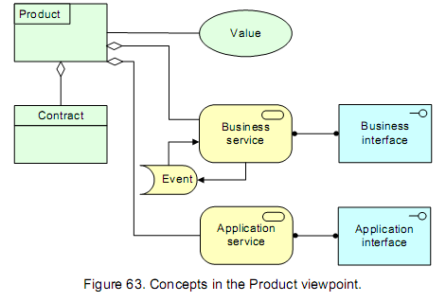

Slide 54
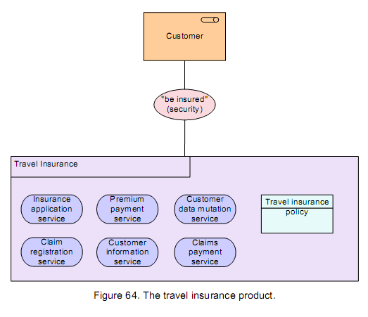

Slide 55
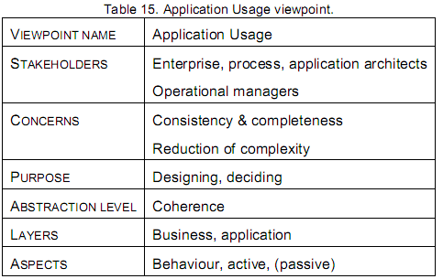
5.1.12 Appl icat ion Usage Viewpoint
The Application Usage viewpoint describes how applications are used to support one or more business processes, and how they are used by other applications.
It can be used in designing an application by identifying the services needed by business processes and other applications, or in designing business processes by describing the services that are available.

Slide 56
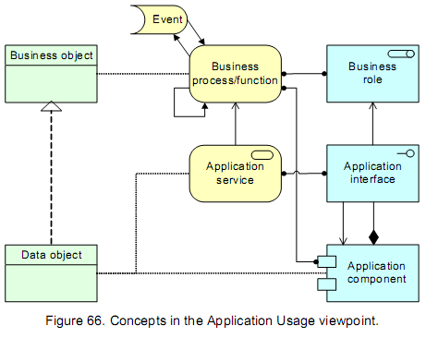

Slide 57
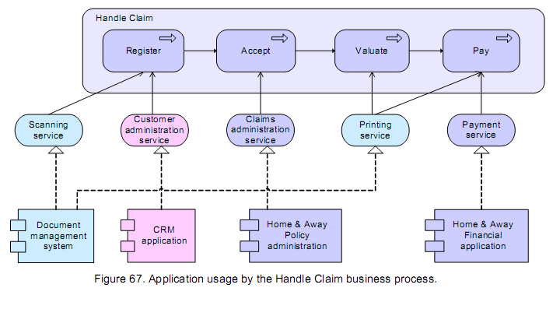

Slide 58
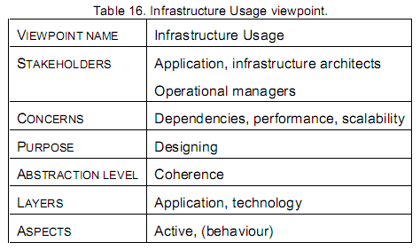
5.1.13 Inf rast ructure Usage Viewpoint
The Infrastructure Usage viewpoint shows how applications are supported by the software and hardware infrastructure: the infrastructure services delivered by the devices, system software and networks are provided to the applications.
This viewpoint plays an important role in the analysis of performance and scalability, since it relate the physical infrastructure to the logical world of applications.

Slide 59
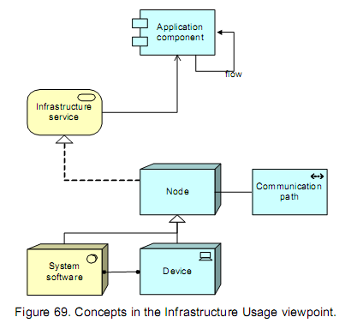

Slide 60


Slide 61

5.1.14 Service Real isat ion Viewpoint
The Service Realisation viewpoint is used to show how one or more business services are realised by the underlying processes (and sometimes by application components).
Thus, it forms the bridge between the Product viewpoint and the Business Process viewpoint. It provides a ‘view from the outside’ on one or more business processes.

Slide 62


Slide 63


Slide 64

5.1.15 Implementat ion & Deployment Viewpoint
The Implementation & Deployment viewpoint shows how one or more applications are realised on the infrastructure.
This comprises the mapping of (logical) applications and components onto (physical) artifacts like e.g. Enterprise Java Beans, and the mapping of the information used by these applications and components onto the underlying storage infrastructure, e.g. database tables or other files.

Slide 65


Slide 66


Slide 67


Slide 68

5.2 Layered Viewpoint
The layered viewpoint shows multiple layers and multiple aspects in one diagram. The main purpose of this viewpoint is to provide an overview of a part of business architecture in a single picture.
Furthermore, it can be used for impact-of-change or performance analysis and for extending the business with new services.

Slide 69
Contents
There are two categories of layers, namely dedicated layers and service layers. The layers are the result of the use of the “grouping” relation for a partitioning of the entire set of objects and relations that belong to a model. The infrastructure, the application, the (application and business) function, the process and the actors/roles layers belong to the first category.
The structural principle behind a fully layered view is that each dedicated layer exposes, by means of the “realisation” relation a layer of services, which are further on “used by” the next dedicated layer.
Thus we can easily separate the internal structure and organisation of a dedicated layer from its externally observable behaviour expressed as the service layer that the dedicated layer realises. The order, number, or nature of these layers are not fixed, but in general a (more or less) complete and natural layering of an ArchiMate model will contain the succession of layers

Slide 70



Slide 71



Slide 72

5.3 Int roductory Viewpoint
The Introductory viewpoint forms a subset of the full ArchiMate language using a simplified notation.
It is typically used at the start of a design trajectory, when not everything needs to be detailed out yet, or to explain the essence of an architecture model to non-architects that require a simpler notation.

Slide 73


Slide 74


Slide 75


Slide 76

5.4 Design Process Viewpoint
The design process viewpoint aims to give insight in the steps taken in the design process, and to visualise these according to the level of certainty or agreement that has been reached about these design choices.
Typical stakeholders of the design process viewpoint are (enterprise) architects that need to communicate the status of the design process.

Slide 77
6 Decision Support Viewpoints
Decision support viewpoints help managers in the process of decision making by offering insight into cross-domain architecture relations, typically through projections and intersections of underlying models, but also by means of analytical techniques.
Such projections and intersections are selections, transformations and mappings of ArchiMate models to lists, tables, matrices and reports.

Slide 78

6.1 Landscape Map Viewpoint

Slide 79


Slide 80


Slide 81
6.1.3 Relat ion to Model l ing Languages
The mapping of ArchiMate models on landscape maps is based on architecture relations.
The dimensions that are used in the landscape maps determine which relations are used.
For instance, the landscape map in Figure 94 relates business functions (hire, train, etc.) to roles (top management, line management, production employee) to systems (information system and applications).
The relation between business functions and roles is directly supported by the assignment relation; the relation between roles and systems is indirectly supported: roles are assigned to processes (or functions) which in turn use systems.

Slide 82
6.1.4 Interact ion wi th Landscape Maps
So far, landscape maps have been used as a static one-way presentation format. We want to use landscape maps as an interactive medium. Landscape maps can be used as a starting point for more detailed models and specifications and it can be used for entering relations between the dimensions chosen.

Slide 83
We envision the following interaction primitives for landscape maps:
  Draw a rectangle (rubber band) comprising one or more cells of the map. The user may choose the color and assign an object (instance of a concept) to the rectangle.
  Extend an existing rectangle with another rectangle that overlaps with the original. Color and label are inherited.
  Modify a rectangle: coverage, color, value.
  Delete a rectangle

Slide 84
Landscape maps can be used as a starting point for navigation as well; relevant interactions are:
  Open a rectangle: detailed specifications or detailed models are shown in a separate window.
  Close detailed specification or detailed models.
  Change granularity of an axis; for instance, business processes can be changed to business activities.
  Link two rectangles by a relation supported by the underlying concept. For instance, if rectangles represent systems, use or composition can be used.

Slide 85

7 Informing Viewpoints
7.1 Process Illustration Viewpoint

Slide 86

Translation rules

Slide 87


